Slide 1
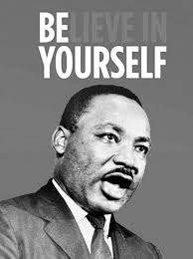
P.H.U.N. Club will meet today after school! Every student is welcome.
Starting at 3:20 in G112
Mr. Dodd’s English Class
With reverence to Dr. King, today’s PHUN club will be reviewing some of his work.

Slide 2
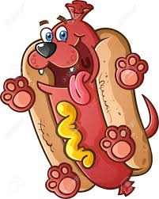
10th: English II
No IPad? Use your phone.
The whole hour. I dare you. You should have these apps anyway. Don’t get caught on social media. You all know how to log into these.
You can:
Work on your “Antigone” review from 1/21 on pg. 1007.
Work on your “Antigone In-depth” assignment from 1/19.
Work on your “MLK” EIO Grind work due next Tuesday 1/26.
Re-read parts of the story
Study for the test on Monday.
Today is a hamburger day.
A day for you to sit on your buns and “catch-up”.
This is not a hotdog day. Nobody shall be laying on their buns. Nobody shall be “dogging” it. Everyone has things to do!
Please be Respectful and Quiet.

Slide 3
9th: English I (4th hour only)
No IPad? Use your phone. The whole hour. I dare you. You should have these apps anyway. Don’t get caught on social media. You all know how to log into these. There are few paper copies. EX: rpdodd87@putnamcitystudent.org pclunch#####
Complete by 10/25, this summary preparation for Part I Quiz on Monday.

