Slide 1
The Odyssey:
Introduction &
Background info

Slide 2
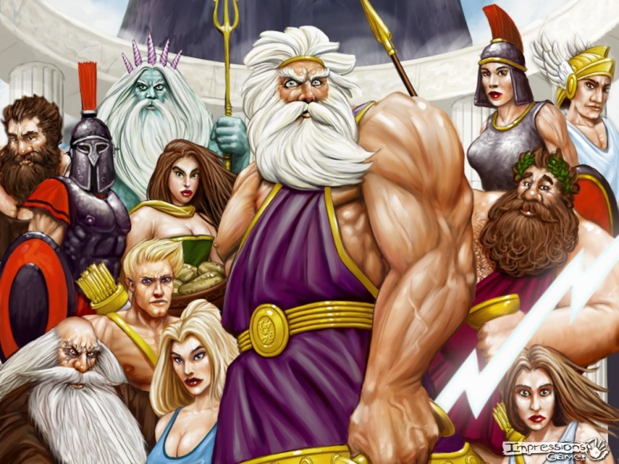
The Gods &
Religious customs
The Greeks believed completely in the existence of gods and goddesses; polytheism
Believed that gods took an active interest in human life
Gods behaved in human ways (possessed human characteristics)
Respect for the gods was essential for success and survival
Greek culture also known for hero-worship
Hero might be the town’s founder or a historical figure who played a major role in an important battle

Slide 3
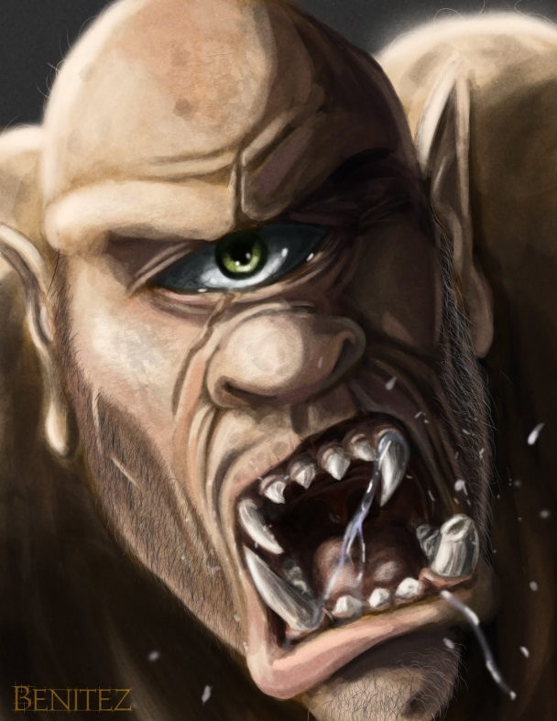
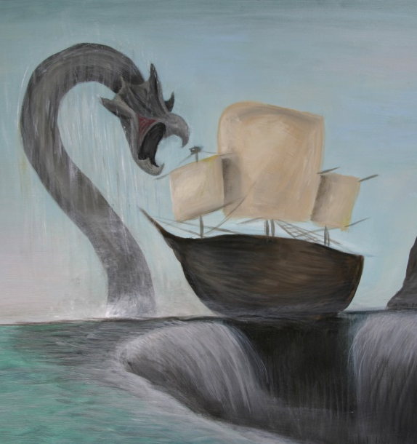
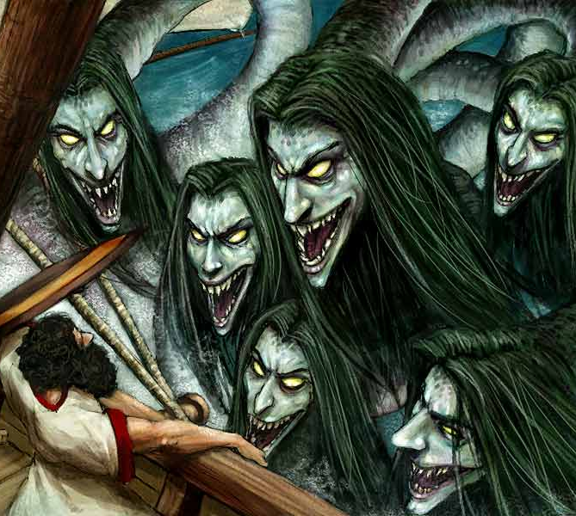
The Gods &
Religious customs
Greeks also believed in monsters and mythical creatures
Siren
Scylla
The cyclops
Charybdis

Slide 4
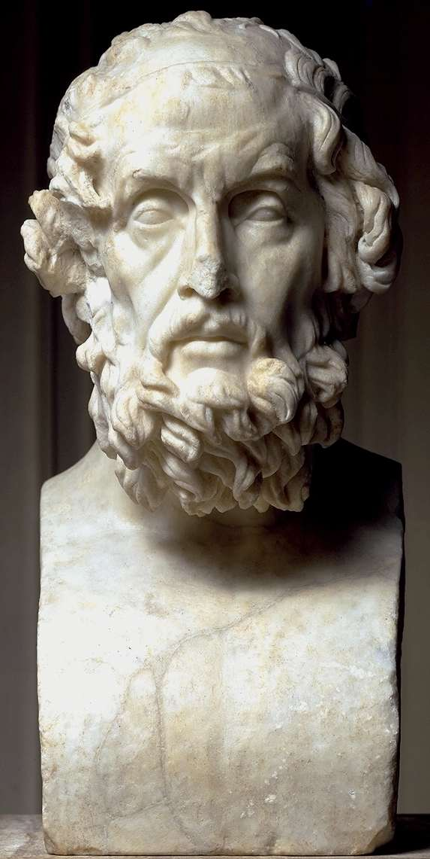
Background info
An epic is a long, narrative poem about a national or legendary hero.
Ancient Greece produced two epics
The Iliad and The Odyssey (900-700 B.C.)
Both written by Homer
Blind
No official information has been found regarding his birthdate or birthplace.

Slide 5
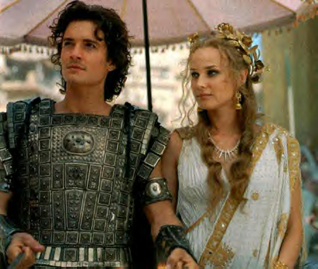
Background info
Trojan War (1200 B.C.)
Legend: war began after Paris (prince of Troy) kidnapped Helen (most beautiful woman in the world) from her husband, Menelaus (king of Sparta)
Menelaus built an army to get back his wife and restore his pride
Odysseus was a soldier in this army
Paris & Helen (from the movie Troy)

Slide 6
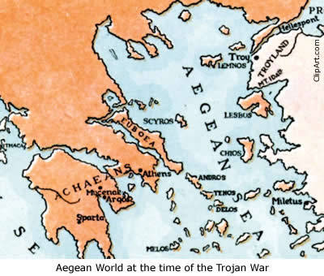
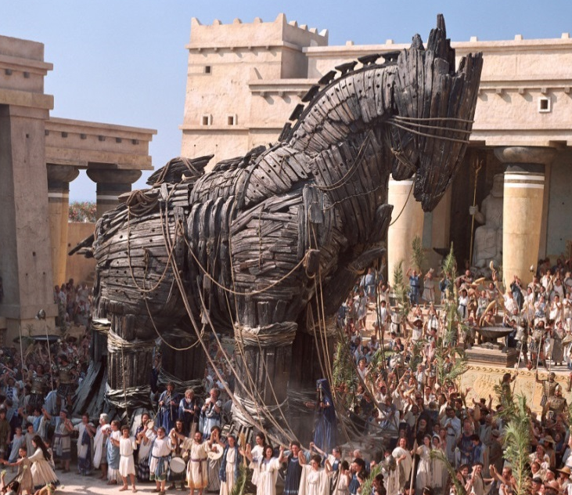
Background info
Odysseus = King of Ithaca
The Greeks battled the Trojans for 10 years, but had little success
Odysseus thought of a plan to trick the Trojans into thinking that the Greeks forfeited
The Trojan Horse
Gave the Greeks access into the city
It worked!
The Greeks defeated the Trojans
*** written between 750-650 BC, but it’s setting is around 12th century BC***

Slide 7
Ancient Greek Values
Intelligence
Glory: equivalent to FAME
War stories
Souls that achieved glory during life were given privileges in Hades
Hospitality: Helping others
Offered food, shelter, protection to travelers without question
Hospitable even when they didn’t want to be
Brotherly duty or fear of the gods?
Loyalty: family, community, & gods
Bravery

Slide 8
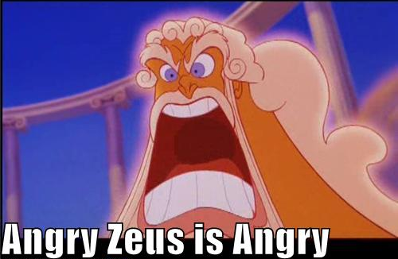
The Odyssey
In The Odyssey, Homer starts by telling about the last days of the Trojan War
The man responsible for the fall of Troy is Odysseus
Trojan Horse story
Because Odysseus was instrumental in Troy’s destruction, he angered the gods who were sympathetic to Troy
The gods vow that he will have a long and difficult journey home.
**This journey takes 10 years and is the subject of The Odyssey.**

Slide 9
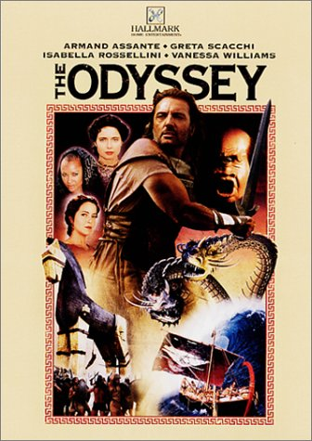
The Odyssey
Odysseus and his men encounter many dangers which make their return to Ithaca difficult:
Monsters
Women who try to keep him from his wife
Somehow, Odysseus always finds a way to get out of difficult situations
Intelligence/cleverness
Quick thinking
Bravery

Slide 10
The Odyssey:
Literary Terms

Slide 11
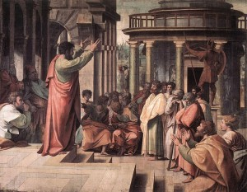
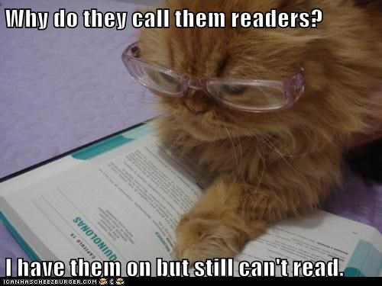
Oral Tradition
Definition: stories that were told and retold verbally from one generation to another
Many ancient Greeks were not literate unless their profession required them to be
Women didn’t have jobs, so most were illiterate
Men who partook in business professions (trading, selling goods) were literate

Slide 12
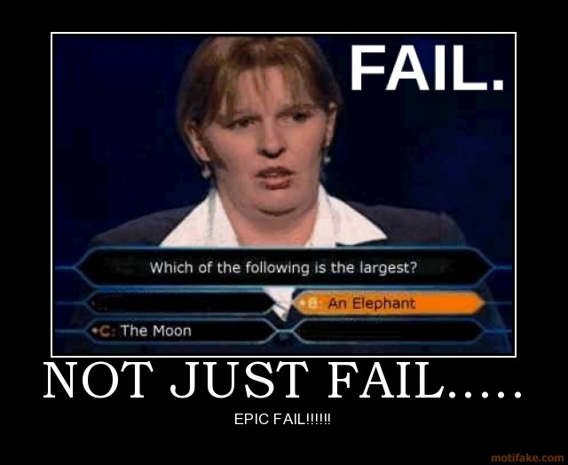
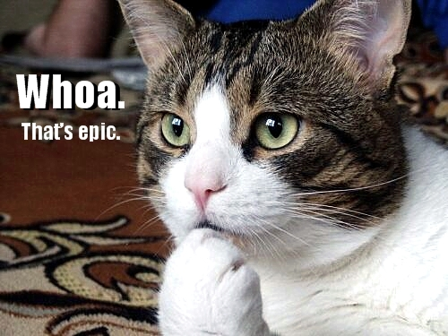
What does it mean if
something is “epic”?

Slide 13
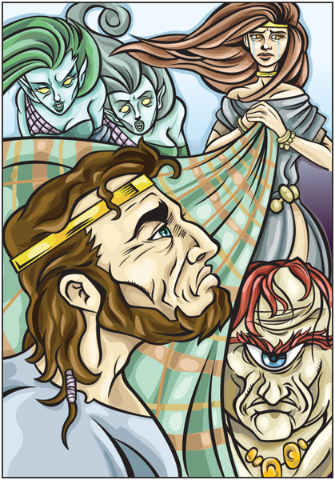
Epic Poetry
Definition: a lengthy narrative poem that usually contains the heroic deeds and events significant to a particular culture or society.
Example: The Odyssey
10 characteristics of epic poetry

Slide 14
Epic Poetry
Characteristics:
Begins “in medias res” (in the middle of things)
Has a vast setting
Features lengthy, formal speeches
Contains divine interventions—THE GODS!
Features heroes that embody the values and morals of the civilization
The protagonist descends into the underworld/hell

Slide 15
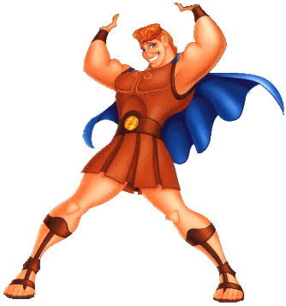
Epic Hero
Definition: the protagonist of an epic poem
Brave and noble character
Admired for great achievements
Affected by great events
Example: Odysseus, Hercules

Slide 16
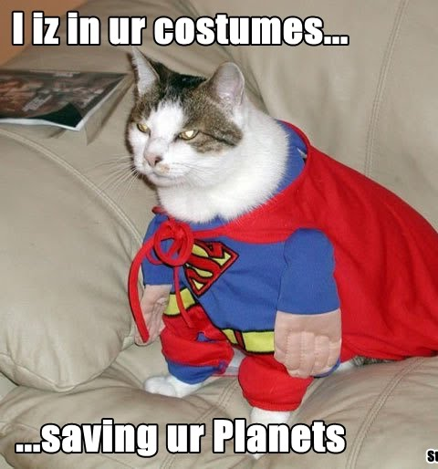
Epic Hero
Epic Hero Characteristics:
Super-human qualities (stronger/braver than others)
Still human, so has a flaw/weakness
Must conquer many difficult tasks
On a quest for something of great value (to him or his people)
Villain(s) try to keep the hero from his quest
Knows that the Gods come first, then heroes, then humans
Physically beautiful

Slide 17
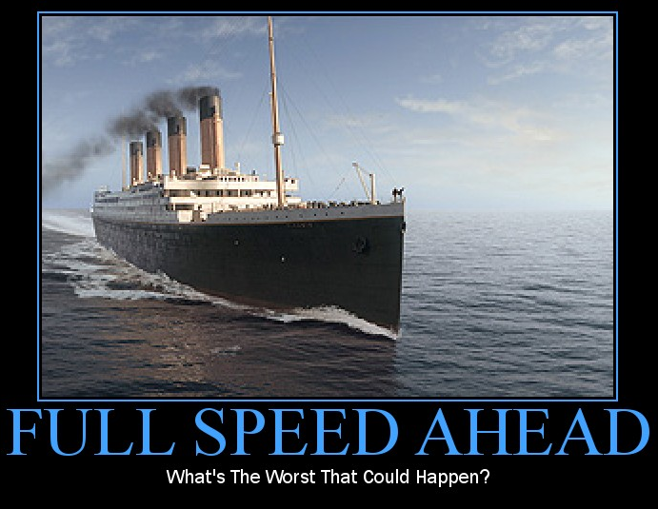
Tragic Flaw
Definition: the character defect that leads to the downfall of the protagonist in an epic or tragedy
Example:
Odysseus’ PRIDE: Odysseus and his men escape from the Cyclops, but as his ship is sailing away, Odysseus yells out that his name is Odysseus, son of Laeretes. He has a great deal of pride, and it often causes him to make rash decisions.

Slide 18
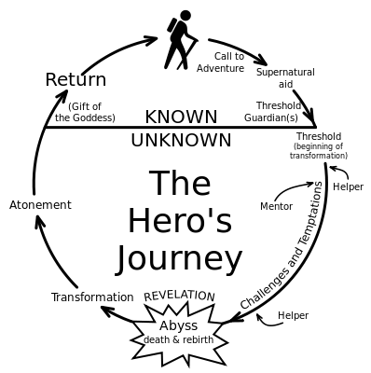
Steps in the Epic Hero’s Journey
1. Call to adventure and/or quest for identity or duty
2. Leaves home for a long period of time
3. Journey consists of difficult tasks
4. Hero must depend on his wit
5. Journey leads to a transformation or self-realization
6. Hero regains his rightful place in society

Slide 20
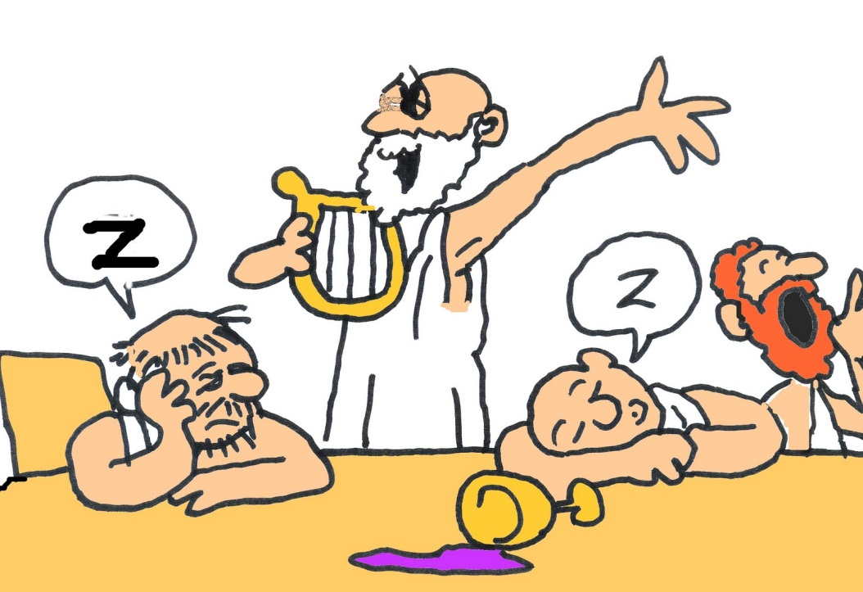
Epic Simile
Definition: an extended simile that is elaborated in great detail and usually runs over several lines
Still uses “like” or “as”
Often contains thoughts that do not relate directly to the plot
Used for emphasis

Slide 21
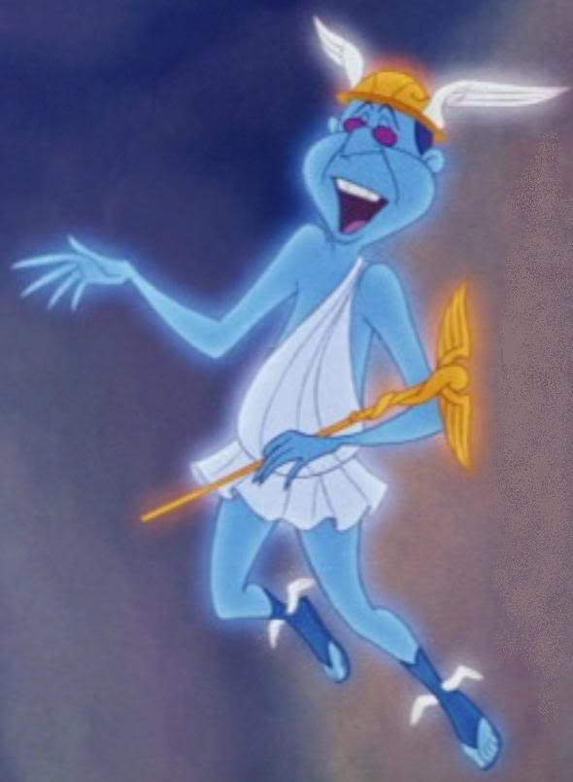
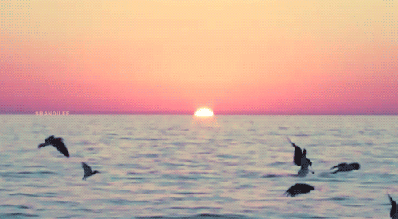
Epic Simile
Hermes flight:
“A gull patrolling between the wave crests of the desolate sea will dip to catch a fish and douse his wings; no higher above the whitecaps Hermes flew until the distant island lay ahead, then rising shoreward from the violet ocean he stepped up to the cave” (Homer 652).
What is Hermes’ flight
being compared to here?

